Slide 1
Carisbrook Flood levees
Community Consultation
Paul Southcott – 1 March 2021

Slide 2
Outline of Presentation
History of project
Sources of flooding
Options considered
Design of levees.

Slide 3
History of project
Carisbrook impacted by flooding 2010 and 2011
Water Technology study completed 2013
Entura completed preliminary design and detailed design in 2016
Water Technology study updated 2019
Entura made minor modifications to design 2020

Slide 4
Sources of flooding
Flooding in Carisbrook from 3 sources:
Tullaroop and McCallum Creeks
From the west of the town
To a lesser extent from the Williams road area

Slide 5
Flood Extents no protection

Slide 6
Flood mitigation
Flood mitigation in Carisbrook by:
Vegetation clearing in Tullaroop and McCallum Creeks
Flood levee to west of the town
Flood levee in Williams road area
A non-return valve on culverts under Landrigan Road near Camp Street
The highway bridge be replaced with a clear-span structure when the bridge is due for replacement in the long term

Slide 7
Preliminary Design: Option A - preferred

Slide 8
Preliminary Design: Option B

Slide 9
Design arrangement

Slide 10
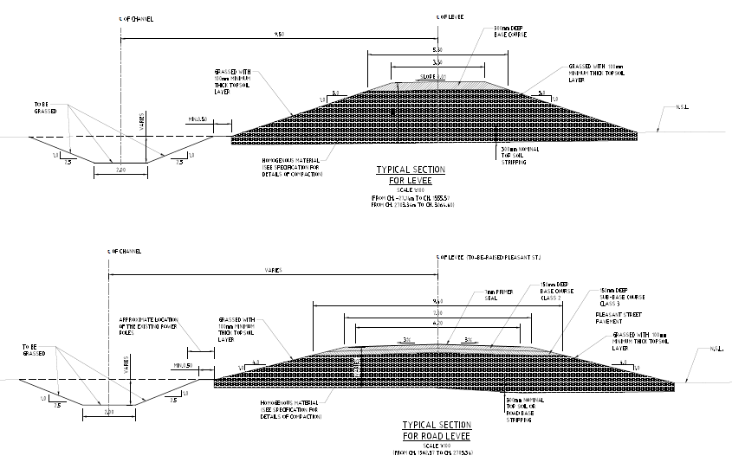
Design section
Channel to carry small floods
1% AEP Flood Level

Slide 11
outcome

Slide 12
END

